Slide 1

UdSU p2p chat
Минималистичный peer-to-peer мессенджер на python
Выполнили студенты группы СПО-О9-09.02.06-11:
Бяков Никита
Иванов Савелий
Кузнецов Михаил

Slide 2
актуальность
актуальность
Цель работы
цель
Задачи
задачи

Slide 3
agenda
Financial overview
Key metrics
Budget
Conclusion

Slide 4
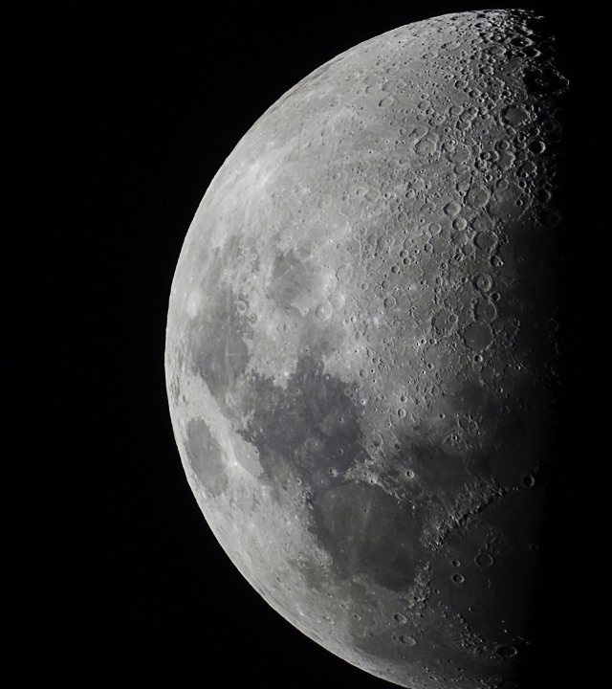
Financial success outlook

Slide 5
Our financial position
Our company continues to experience significant growth via strategic financial planning and our ability to adapt to changing market conditions.

Slide 6
KPIs driving success
Growth rate
We’ve achieved a 22.9% revenue increase over the past fiscal year, exceeding projections. This growth has exceeded our projections and is a testament to our effective strategies and operational efficiency.
Profit margins
As a result of our sustained operational efficiency, we have sustained a 20% profitability rate. By focusing on profit margins, we have been able to remain profitable while also driving growth.

Slide 7
projected revenue growth in the next 12 months
25%

Slide 8
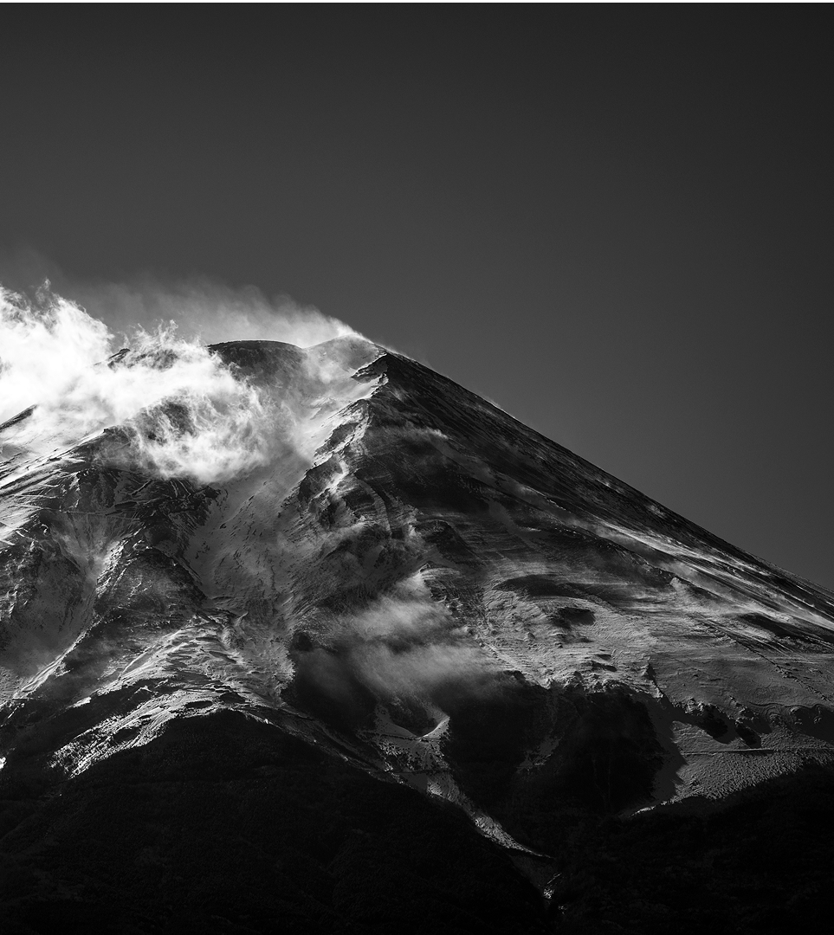
Forecasting for the future

Slide 9

Financial growth & objectives
Short-term goals
Our immediate focus is on cost control and operational efficiency to maximize cash flow. Long-term growth
For our long-term growth, we are committed to expanding into new markets while maintaining financial stability. Risk mitigation
To safeguard our business against potential risks, we will develop strategies to hedge against economic downturns and market volatility.

Slide 10

Budget allocation
By focusing our financial resources on high-impact areas like technology and talent acquisition, we aim to drive innovation and enhance our competitive edge.

Slide 11
Quote
Smart financial decisions today drive lasting success for the future.

Slide 12
Budget allocation & growth forecast
Category | Budget allocation | Projected growth | ROI expectation
R&D investment | $75M | +20% annually | High
Marketing | $50M | +15% annually | Moderate
Operations | $40M | +5% annually | Stable
Tech upgrades | $30M | +25% annually | High
Market expansion | $80M | +30% annually | High
Cash reserves | $25M | N/A | Essential

Slide 13
Andrew Carnegie
“The first one gets the oyster, the second gets the shell.”

Slide 14
Strategies for sustainable growth
High-return opportunities
Targeted investments support long-term expansion. By focusing on high-return opportunities, we can maximize our growth potential and achieve sustainable success. Technology integration
Leveraging AI and automation to drive financial efficiency. By integrating advanced technologies into our operations, we can streamline processes, reduce costs, and enhance productivity. Market expansion
Entering new territories to maximize profitability. Expanding into new markets allows us to diversify our revenue streams and reduce our reliance on existing markets. Risk management
We implement strategies to hedge against financial uncertainties. By proactively managing risks, we can safeguard our business against potential threats and ensure long-term stability.

Slide 15

Moving forward with confidence
Financial stability
We remain committed to strong financial management.
Strategic investments
Our next steps focus on long-term value creation.
Sustained growth
We’re positioned for scalable expansion in the coming years.

Slide 16

Thank you
Presented by Frey Munch

